Slide 1
INTRODUCTION (GGE295)
Project Name:
SP9-GGE295 DC-DC Converter 12V-10A & 5V-1A
.
Objective- To Development Electronics part (DC Power Supply ) for E Vehicle .
Scope- DC DC Converter is converter which converter High DC voltage to Low voltage with below Spec.
Input Rating - 35-90V DC, Output Rating 12V-10A and 5V 1A DC , Enclosure- IP 65.
Hardware side - Designing part of this Converter using one of the SMPS topology based.
Software side- No any scope of work.
Mechanical Side- To develop IP 65 Enclosure in aluminum casing
Measurement Goals - SV: ±20% , PDD: 0.10±0.02 , PPDD : 0.20±0.02
Link to Project Data : HTTP://192.168.100.9:8080/SVN/DC_DC_Converter/SP9_GGE295
Team Size: 10 Nos. Effort Size: 156 hrs. Time Line : 19-7-2022 to 20-8-2022
Actual Scheduled Start to Finish Date: 19-7-2022 to 31-8-2022

Slide 2
Requirement Development
Initial Requirement received from Sr. management in form of VOC and one nos. sample product.
VOC Format link as GGE295_Voice of Customer-Idea Vetting
Requirement capture form sample product testing result and making functional specification & requirement traceability table .
GGE295_Requirement Capture & Elicitation
GGE295_FUNSPC
GGE295_REQTRT
Sr. No | Need Statement | Elaboration
1 | Input source ( Li-ion battery ) | 48/60/72V
2 | Converter type (conman ground) | Non isolated
3 | Input voltage range (40 to 84V) | 35V to 90V DC
4 | Output Voltage 12 VDC | 12 +/- 0.5V DC
5 | Output Current 10A | 10A +/- 0.5 A DC
6 | Output Voltage 5 VDC | 5 +/- 0.5V DC
7 | Output Current 1 A | 1A +/- 0.5 A DC
8 | Efficiency (> 88%) | >88% at working range
9 | Over current Protection (>10A) at 12 V output | Output voltage start to reduce
10 | short circuit protection at 12 V output | output voltage reduces to zero
11 | Over current Protection (>1A) at 5 V output | Output voltage start to reduce
12 | short circuit protection at 5 V output | output voltage reduces to zero
13 | Enclosure Type aluminium IP 65 | IP 65
14 | Output cable for 12V | 150 mm with 3 pin Connector
15 | Output cable for 5V | 150 mm with 2 pin Connector
VOC
Product Power Ratings-120W
Input Parameters-Battery Voltage= 60 V
Output Parameters-12V 10A and 5V 1A for Mobile Charging
Effort Estimation give us the estimated effort size 157.13 person hrs. . GGE295_ESTFNL
Project Planning in Einframe - Project Plan Link-HTTP://gil.einframe.com/rptprojectoverview.aspx

Slide 3
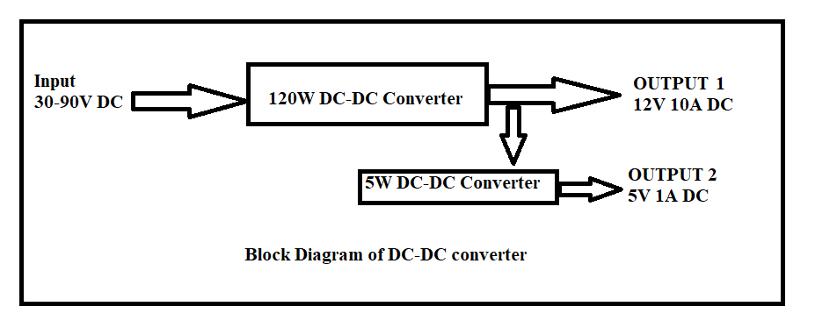
Design and Implementation
To build a technical solution for meet the requirement hardware design , mechanical design and interface & integration design is done and respectively document developed.
Design document as listed below.
GGE295_HDWDSN- Hardware design document is electrical requirement technical solution that is all hardware modules .
GGE295_MCHDSN- Mechanical design document is mechanical requirement technical solution ,that is enclosure and external part.
GGE295_INTDSN- This design document is interface and integration of all modules with to each other and build complete product as per requirement.
Hardware Modules-120W DC-DC Converter 12V-10A
Description
Topology selection
Logical Flow
External Interfaces (if any)
Internal Dependencies
Critical Design Consideration
Design Alternative Consideration
Development & Execution Environment
Safety Consideration
Component Selection and Details
Prototyping and its results
Schematic and Layout considerations
Failure modes and Mitigation steps
Reuse Components
GGE295_HDWDSN

Slide 4

Key Modules-
First- 120W DC-DC converter : Input 30-90V Dc and output 12V -10A DC.
Second- 5W DC-DC converter :Input 12V DC and output 5V -1A DC.
Criteria for design decisions-
Input Voltage =35-90VDC
Output Voltage = 12VDC
Output Current =10ADC
Efficiency=>85%
Isolation - NON- isolated
Input voltage > output voltage so applicable topology is buck and Fly back converter
Non isolated SMPS topology decided -Buck converter
Interface item consideration - 3 pin cable for input battery and output connection.
Topology type Selection-
1. Synchronous Buck converter (comparatively high cost / high complex/ new part involvement)
2.Asynchronous Buck converter (low cost /low complex/ less new part involvement)
Design Document Review - Review using review check list
Outcomes
Modules Schematics and its prototype result
Layout consideration
First Draft BOM (passive and active part)
Basic design of enclosure
Design Alternative Consideration -Synchronous type buck converter ,but cost will be differ and higher side.
Reuse Components
PWM IC 3845 50% max Duty Cycle , Capacitor 100V 220uF , Capacitor 1000uH 25V, Mosfet IR4110 100V 120A , Diode FERD20H100ST 100V 20 A

Slide 5
Interface document
Interface for input and output 12V10A 3 pin cable on PCB Board
Interface of 5V USB Supply cable on PCB Board
PCB and enclosure interface .
Thermal interface between Mosfet and enclosure using thermal pad
Outer assembly(Grove met ,side plate ,gasket ) interface for IP enclosure.
Packaging related interface .
Implementation Outcomes
Schematic No-G0449P1157 Rev. 1.0
PCB Layout-G0449P1157 Rev. 1.0
Enclosure Drawing-HW_2856
Mounting Plate Drawing-HW_2859
Packaging Box Drawing-HW_2875
Inductor drawing -HW_2883
Side plate Drawing-HW_2896
3 Pin Harness Drawing-HW_2857
2pin USB Drawing-HW_2858
Thermal Pad Drawing-HW_2874

Slide 6
Hardware Module test Case and Ids
UVLO and Start Up Test- HWD_3.1_A
Voltage Regulation Test- HWD_3.1.B
Voltage stress at Power device- HWD_3.1_C
Efficiency Test - HWD_3.1_D
Output Ripple Test- HWD_3.1_E
Overload and short circuit test- HWD_3.1_F
Heat Run Test- HWD_3.1_G
Integration document and Integration IDs
Side Plate HW_2896 and Rubber grove-met Integration -INT_1
harness HW_2857 and Harness HW_2858 integration INT_2
PCB assembly integration INT_3
Thermal Pad and Mosfet integration INT_4
PCB assembly in enclosure integration INT_5
Side cover on enclosure integration INT_6

Slide 7
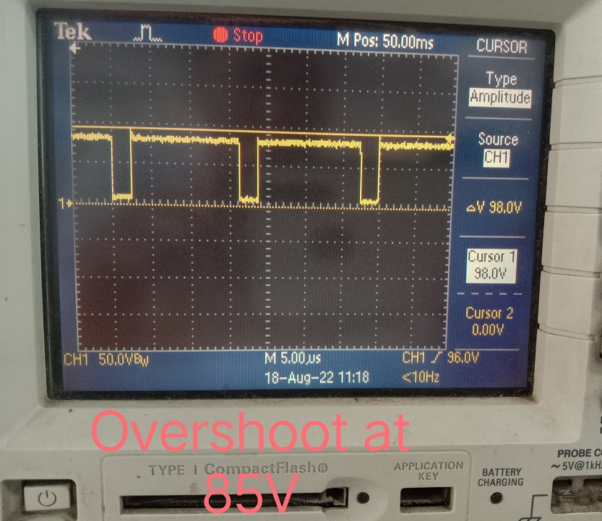
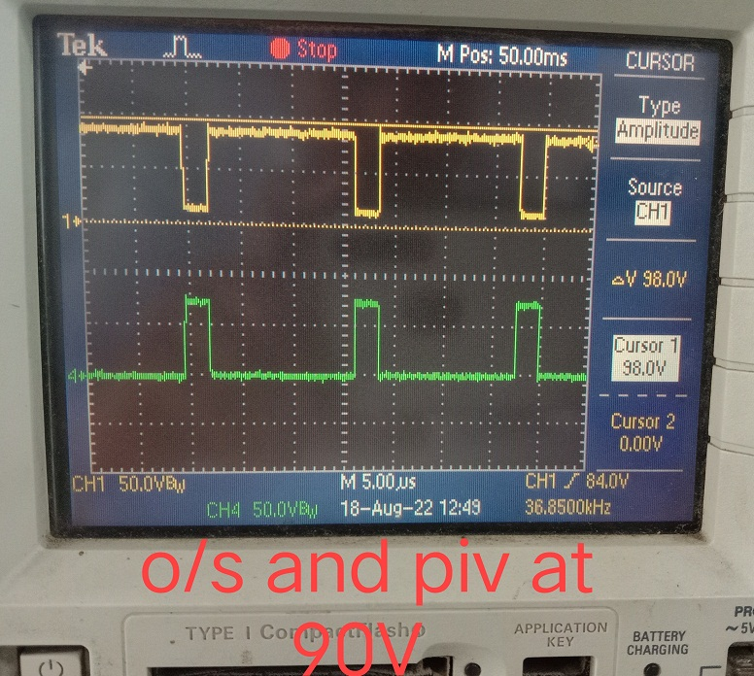
Hardware module test Report-REPORT_HWTCAS
System test Case and Ids
UVLO and Start Up Test- VAL_1
Voltage Regulation Test- VAL_2
Efficiency Test - VAL_3
Output Ripple Test- VAL_4
Overload and short circuit test- VAL_5
Heat Run Test- VAL_6

Slide 8
Closure

